Slide 1
Chapter No:3
Logic Gates

Slide 2
CHAPTER OUTLINE
The Inverter
The AND Gate
The OR Gate
The NAND Gate
The NOR Gate
The Exclusive-OR and Exclusive-NOR Gates

Slide 3

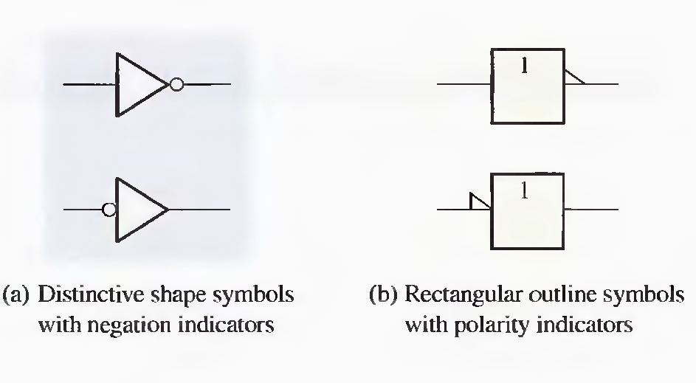
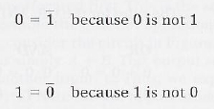

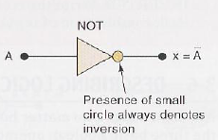
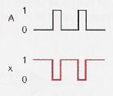
NOT OPERATION
Boolean Expression :

Slide 4

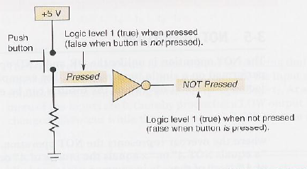
EXAMPLE

Slide 5
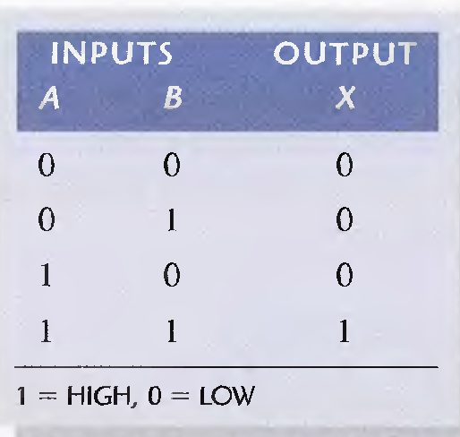

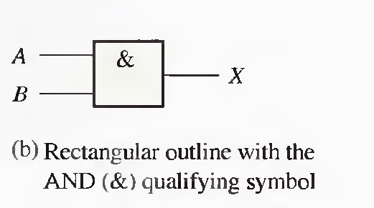
AND OPERATION WITH AND GATES
The Boolean expression for AND operation :
X= A.B
Circuit symbol Truth Table

Slide 6
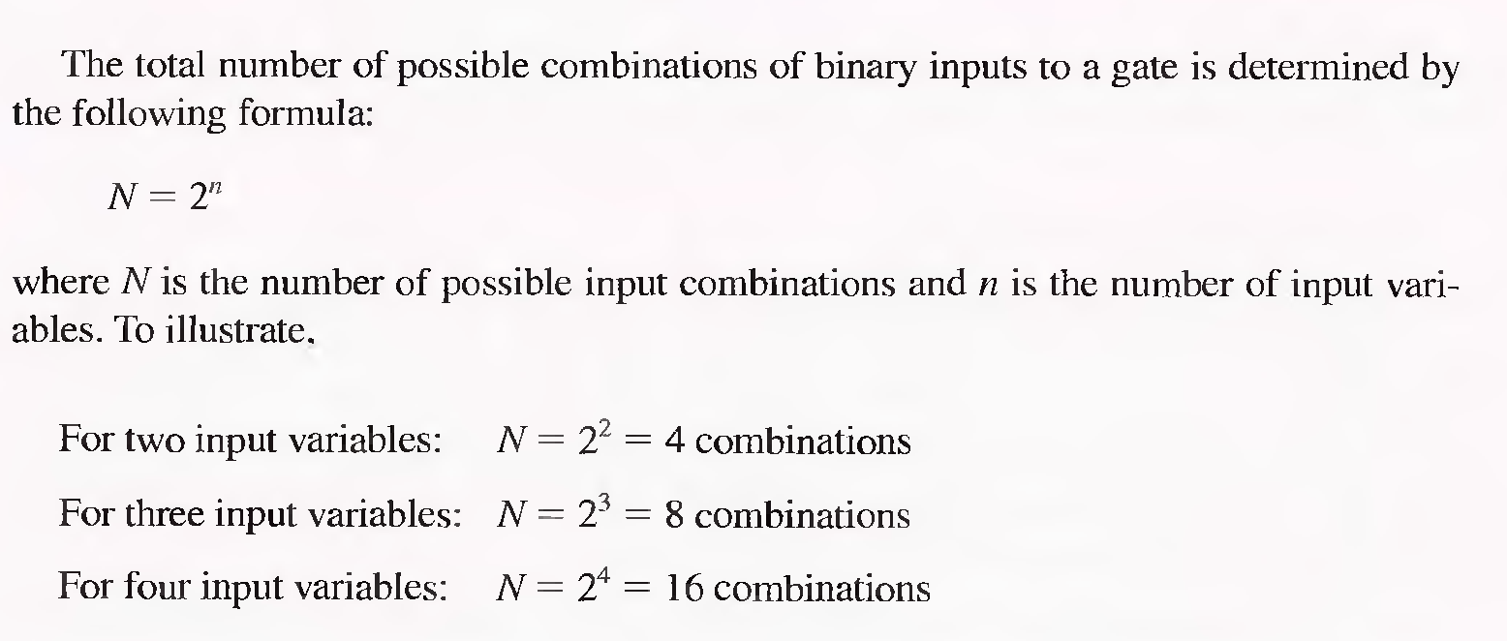
Possible Combinations of binary input to a gate

Slide 7
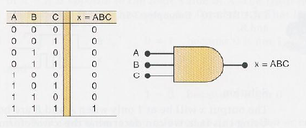
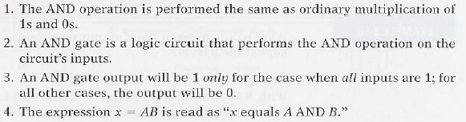
AND OPERATION FOR THREE INPUT
X = A.B.C
Important point :

Slide 8
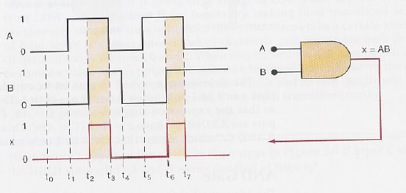
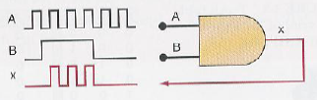
EXAMPLES

Slide 9

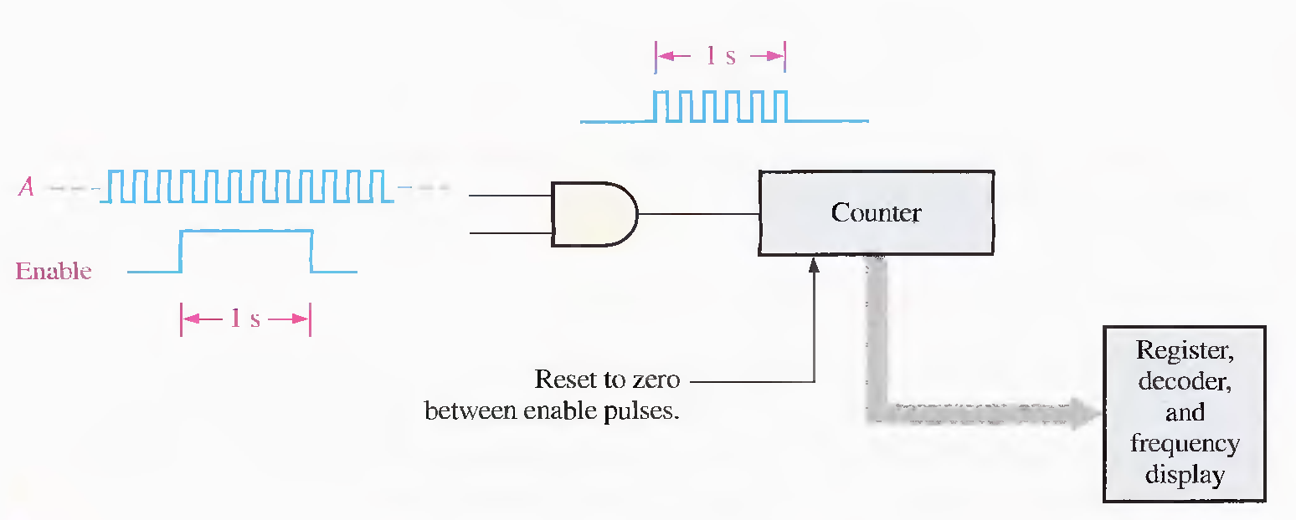

Slide 10

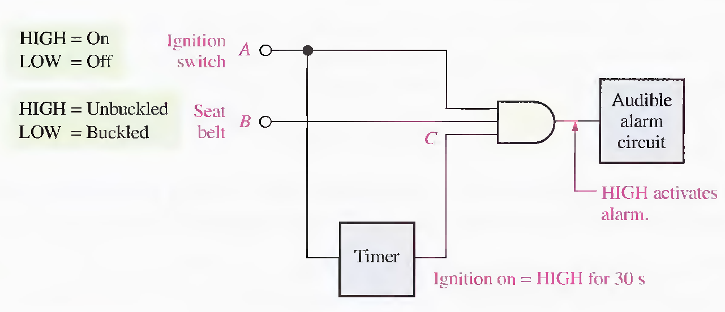

Slide 11
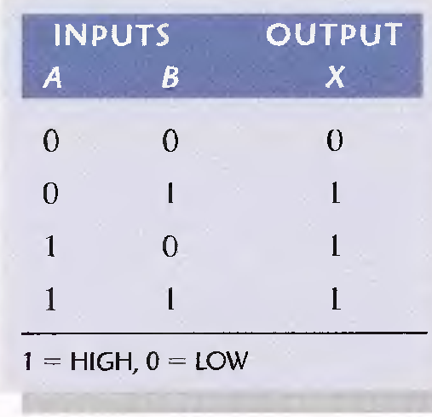
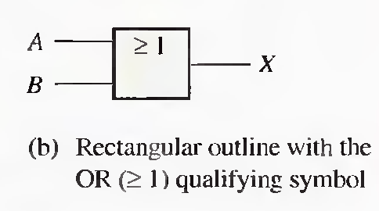
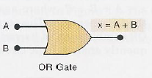
OR OPERATION WITH OR GATES
The Boolean expression for OR operation :
X= A + B
The Truth Table
Circuit Symbol

Slide 12
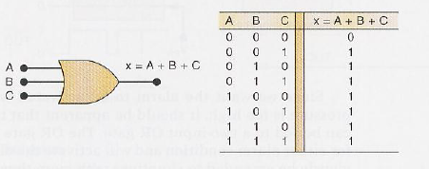
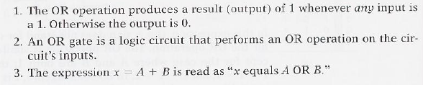
OR OPERATION FOR THREE INPUT
X = A+B+C
Important point :

Slide 13
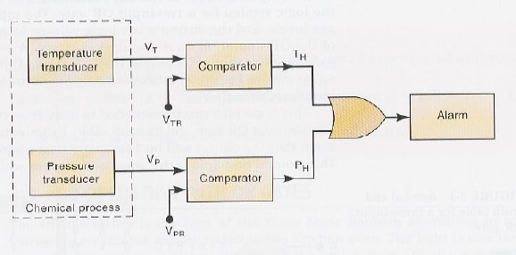
APPLICATION OF USE OF OR GATE IN AN ALARM SYSTEM

Slide 14

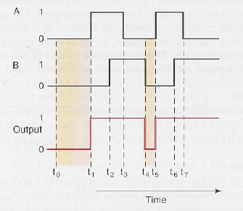
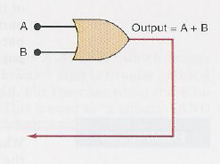
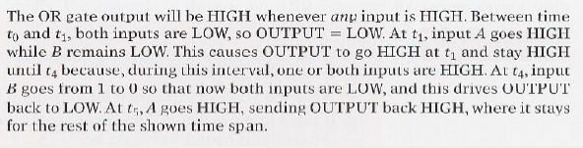
EXAMPLES

Slide 15
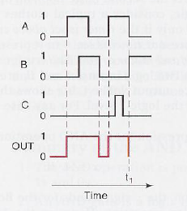
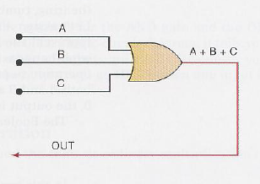
EXAMPLES

Slide 16
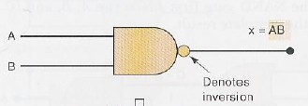


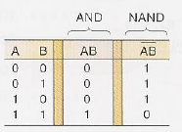
NAND GATE:
Symbol :
Equivalent Circuit :
Truth Table :

Slide 17
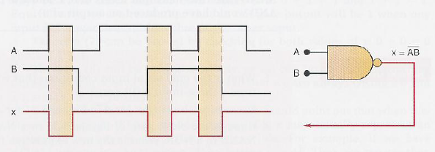
WAVE FORM AT THE OUT PUT OF NAND GATE
Operation of NAND Gate

Slide 18
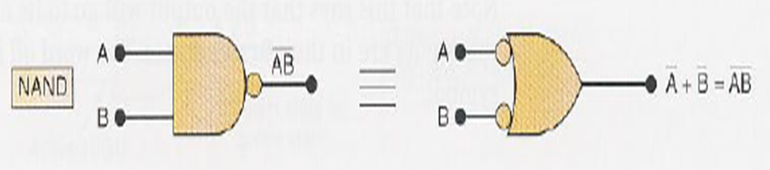
NEGATIVE –OR EQUIVALENT OPERATION OF A NAND GATE

Slide 19

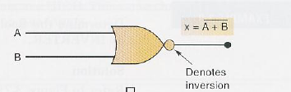


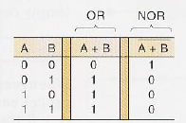
NOR GATE
Symbol :
Equivalent Circuit :
Truth Table :

Slide 20

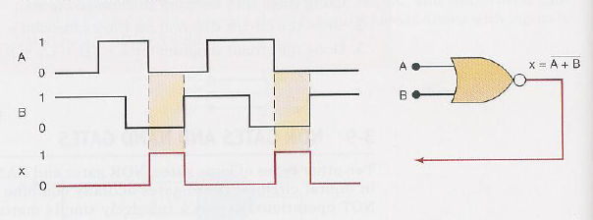
WAVE FORM AT THE OUT PUT OF NOR GATE
Operation of NOR Gate

Slide 21
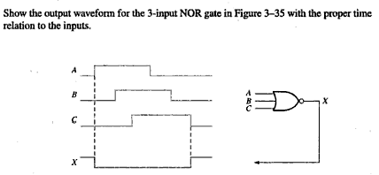
EXAMPLE

Slide 22
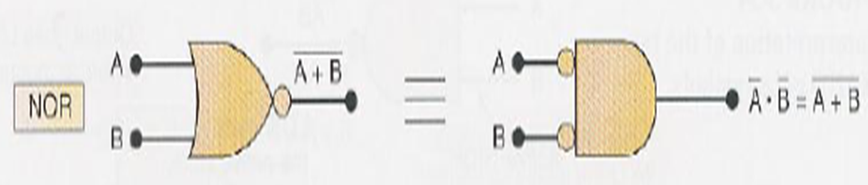
NEGATIVE –AND EQUIVALENT OPERATION OF THE NOR GATE

Slide 23
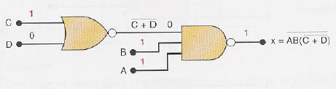
EXAMPLE

Slide 24


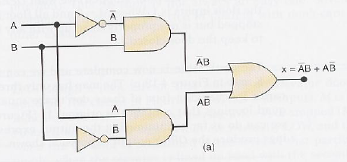
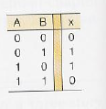
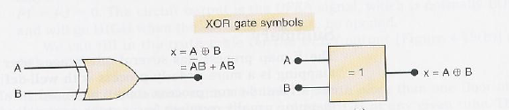
EXCLUSIVE – OR

Slide 25

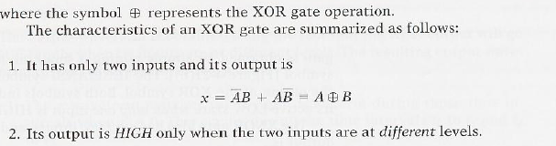
EXCLUSIVE – OR

Slide 26


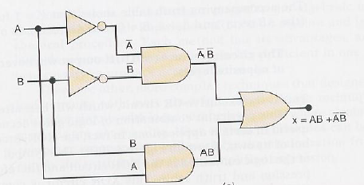
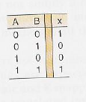
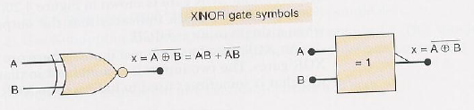
Exclusive – NOR

Slide 27
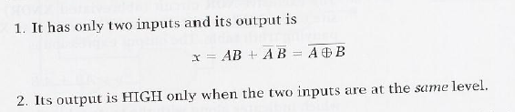
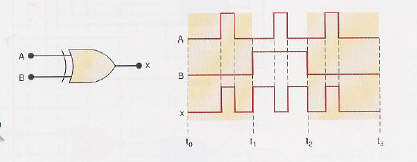
Exclusive – OR

Slide 28
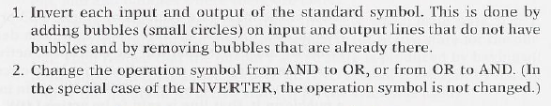
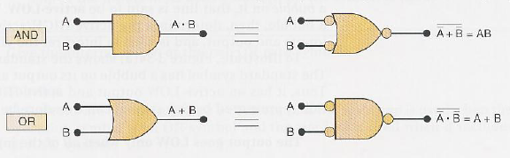
ALTERNATE LOGIC GATE REPRESENTATIONS
The alternate symbol for each gate is obtained from the standard symbol by doing the following :

Slide 29
